Slide 1
Team #1 PICA: Design Decisions and Current Status Report
A. Ball, N. Jen, A. Sterk, K. Wiersma
Notes:
It covers a lot of good stuff. Keep in mind that you only have 6-7 minutes though, and with 10 slides, that’s 1.5 slides a minute.
If you need more time, you could probably take out a few of the smaller aspects of the project (they don’t need to know every single detail like we do…)

Slide 2
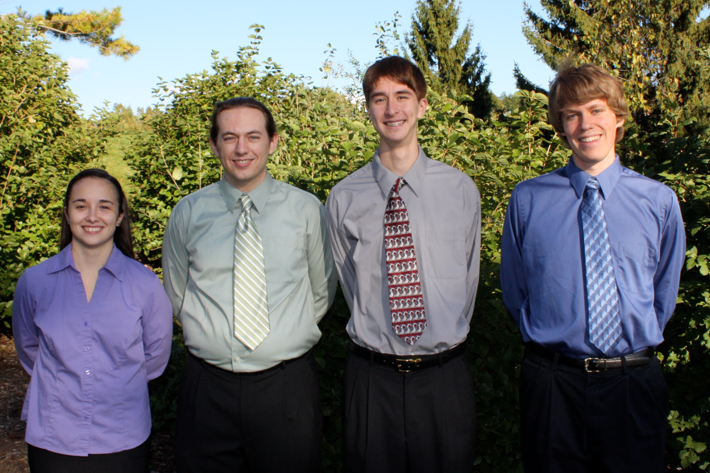
Amy Kendrick Nate Avery
Notes:
Kendrick: Do we really need this slide anymore? Maybe incorporate it into the title slide (change the presentation theme if you have to).

Slide 3
Outline
Reintroduction of project and problem
Overview of Schedule
Major Design Decisions
Accomplishments
In Progress Tasks
Obstacles
Summary
Notes:
Overview of schedule and in progress tasks could be combined into one slide. Possibly consider using a helpful table or graphic (maybe from our Gantt chart)?

Slide 4
Our Project
Consumers do not know enough about how, or where the electricity they purchase is being used.
Goal is to track how power is used on a circuit-by-circuit basis and easily display that information to the customer.
Market to both power companies and home/business owners.
Notes:
Nate: Circuit by circuit is One of our goals, but not the only one – might want to make that clear
Kendrick: I think they know this, lets ditch the text (you can still describe it) and put a system diagram in here instead, focus this back onto the technical side of things while maintaining the big picture. Lets show that we have some technical prowess here ☺

Slide 5
Overview of Schedule
Each team member is working on smaller subsections of the project with the big picture design in mind
Power Supply
MSP430
Solid State Relays and ADE7763 chips
LEON3
External Deadlines
Notes:
Nate: Not sure how the first bullet relates to our schedule, unless you mean to say that we’re parallelizing our work?
Kendrick: I think we have some deadlines set for ourselves, lets maybe discuss some of those? Also, axe some text, short descriptions, say the text use the slides for graphics.

Slide 6
Major Design Decisions
Power Supply
Solid State Relays
Microprocessor Selection
Notes:
Nate: I could be wrong, but moodle sounds like design decisions should be a big part of the presentation. If that’s true, then following what appears to be your style, this slide should have more text.
Kendrick: Needs more content, maybe 2-3 slides on this topic, cut some of the other fluff. Lets show some detailed system diagrams here maybe? I think we decided that we needed some power supplies? I’d say that was a fairly major decision. Keep this specific, not general. For example: we decided that we were going to use solid state relays for their switching capabilities, now lets show how they are going to be used. Which microprocessors did we select and why? What were our major concerns with each of these decisions?

Slide 7
Accomplishments
PPFS Completion
Successful testing of the Solid State Relays
Successful testing of the analog inputs to the ADE7763 chips.
Run code on LEON3 processor
Notes:
Kendrick: Need to add MSP430 stuff– 1. MSPGCC 4.X compiled so we can now compile (and debug) code for the MSP430, 2. Demoed capability to read from the ADC in the MSP430, still need to interpret results… binary measurement -> voltage. Also, haven’t we reported successful testing of the analog inputs before? Also, PPFS completion…yeah that was an accomplishment but everyone did that, it’s a class deadline, lets focus on technical progress of the project. Didn’t you (Amy) design a power supply PCB?

Slide 8
In Progress Tasks
LEON3- Base Station
MSP430- LCD Display
Solid State Relays- Breakers
Power Supply PCB: ADE7763 Chips
Notes:
Kendrick: MSP430 – LCD display driver and ADC ISR. Also “Solid state relays – Breakers” is extremely ambiguous and vague --- lets get some SPECIFIC tasks with descriptions that we can measurably look at in our next presentation, remember Neisen’s SMART acronym: Specific Measureable Attainable Realistic Time-oriented. We want to be able to look back to this presentation next time and specifically state what has changed.

Slide 9
Obstacles
Short time left to complete project
Leon 3: Linux will not correctly identify all the parts on the board, which causes the boot process to fail.
Notes:
Short time left seems too general to be in here – it’s true for everyone ← I agree, get rid of this.
Another one might be that none of our systems have worked together yet
Kendrick: integrating surface mount components into DIP breadboards, toolchain compiles not working well due to very out dated code. Dealing with demo software (limits on compiled size).

Slide 10
Summary
Short schedule to complete project
Goal of having a clear deliverable per week.
Design Decisions have been made
Many accomplishments as well as obstacles
Confident that the prototype will be ready by May 7.
Notes:
I wouldn’t include the deliverable goal as I didn’t see it mentioned before (although you could be planning on verbally mentioning it…)
Watch capitalization and punctuation consistency (this slide and others)
Kendrick: Scratch the deliverable thing in the summary, this is not something our audience needs to know as this is an in-team goal. Focus on our design decisions. Overall comments: Focus this presentation down onto the design decisions and progress that we have made, cut some of the fluff and make the slides meaningful to the audience.

